Slide 1
PREDICTING Number of hours worked: Regression, classification, Clustering and association
By Gavin Whitesitt

Slide 2

MOTIVATION
The number of hours in a week that are worked determines much of our life experience
Understanding common sets of characteristics associated with long and short working hours might help us better understand why these decisions are made
Exploring different clustering methods to see if there are any meaningful groupa within the data

Slide 3
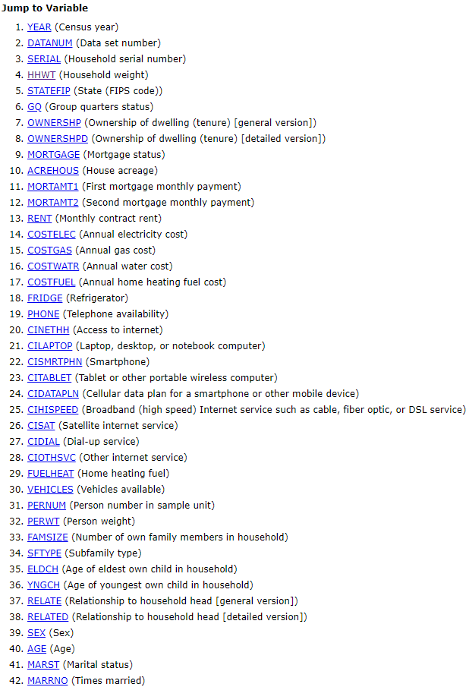
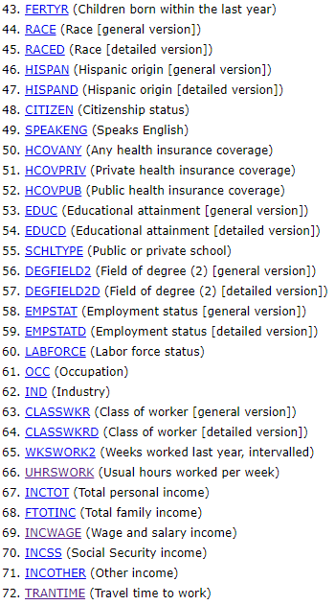

GETTING TO KNOW THE DATA
IPUMS USA collects, preserves and harmonizes U.S. census microdata and provides easy access to this data with enhanced documentation
3,156,467 rows and 259 columns after preprocessing.
20 continuous and 239 categorical features.
All data retrieved is from 2016

Slide 4
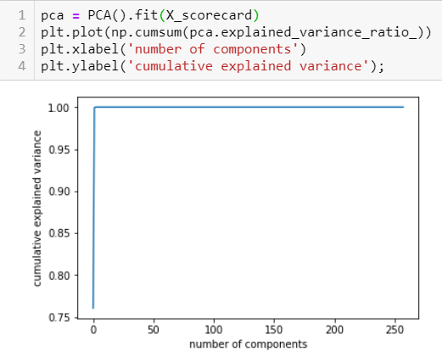
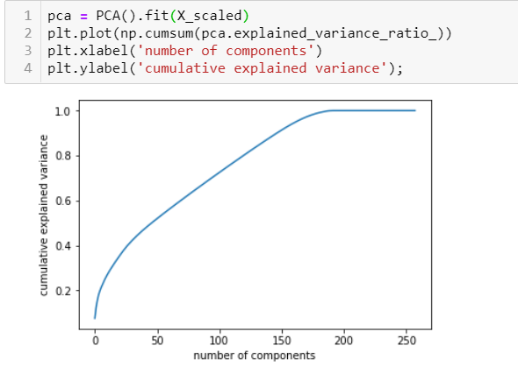
PRINCIPLE COMPONENT ANALYSIS

Slide 5
Regression
Models Built
Linear Regression
Ridge Regression
K Nearest Neighbors Regressor
Lasso
Decision Tree Regressor
Ada Boost Regressor
Extra Trees Regressor
Random Forest Regressor
Bagging Regressor
Target variable: UHRSWORKED
UHRSWORK: reports the number of hours per week that the respondent usually worked, if the person worked during the previous year.
Explanatory variables: 259 variables discussed earlier in data section

Slide 6
Test *5 fold cross validation
Model
Train
83%
Linear Regression
83%
79%
KNN k=50
NA
87%
98%
Random Forest
83%
Lasso
83%
85%
Ada Boost
86%

Slide 7
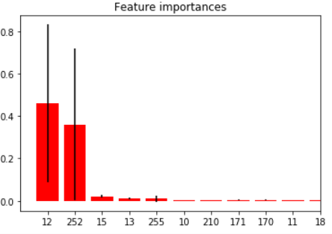
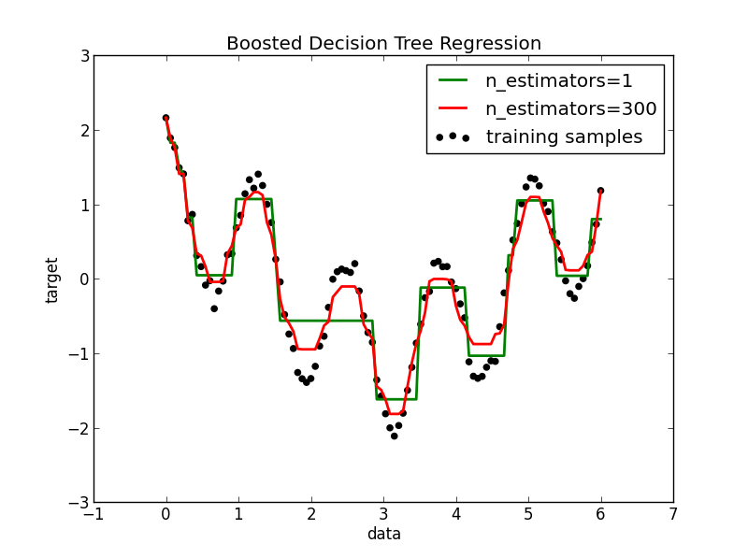

Random forest
A closer look at the best performing model
Random forest creates multiple decision trees from random samples of the train data. These models are then bagged to create a random forest model
Looks like two features are vastly more important than the rest.

Slide 8
Classification
Models Built
Naïve Bayes
Logistic Regression
K Nearest Neighbors
Decision Tree Classifier
Random Forest
Gradient Boosting Classifier
Support Vector Machine
Perceptron
Bagging Regressor
Target Variable: Sex of observation
Explanatory variables: 259 variables discussed earlier in data section

Slide 9
Test Area under ROC curve
Model
Train
51%
Naïve Bayes
52%
78.4%
Decision Tree
79%
79%
100%
Random Forest
52%
SVM
100%
50%
Perceptron
39%

Slide 10
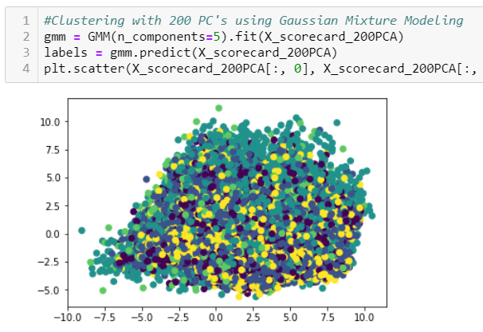
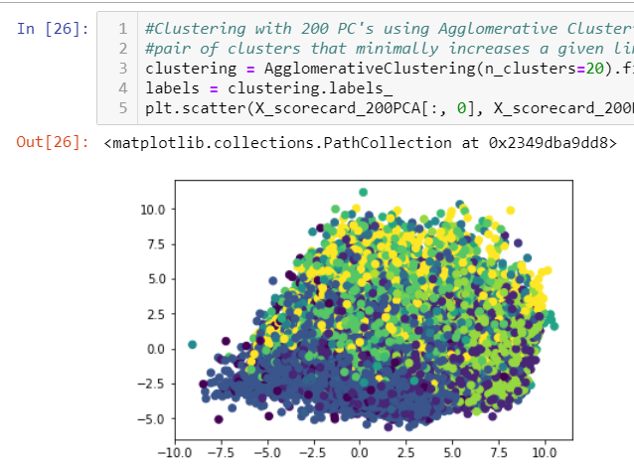
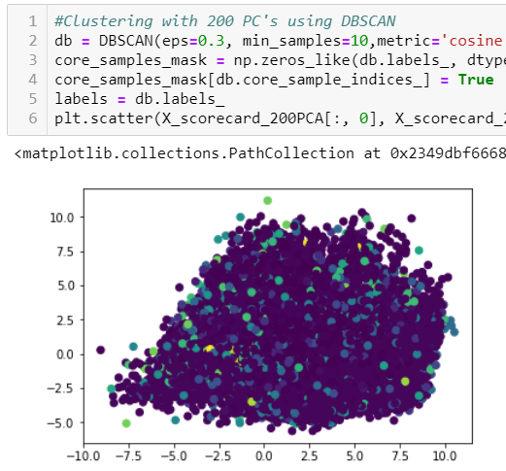
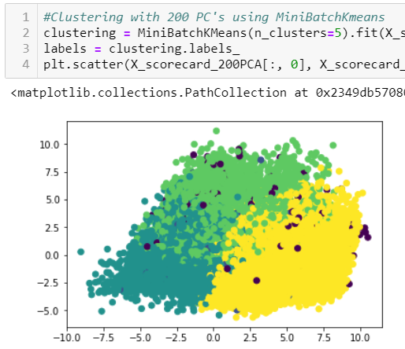
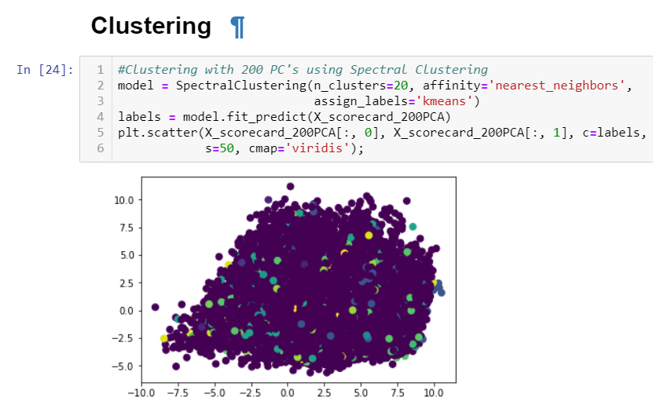
Clustering

Slide 11

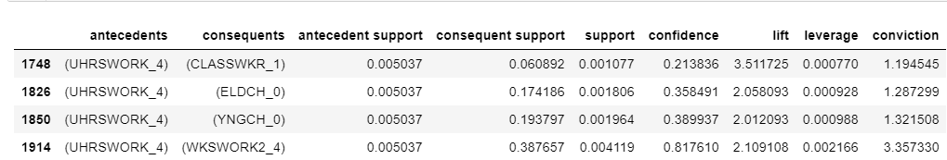


Association RULES

Slide 12

Improvement
THE IPUMS website offers a 1% or greater sample of the US population for every year dating back to 2000
It would be interesting to do something analyzing the changes in association rules over time to better understand the how the American family and individual has changed over time.

Slide 13


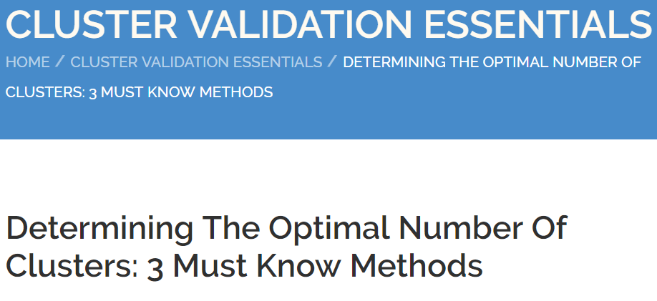

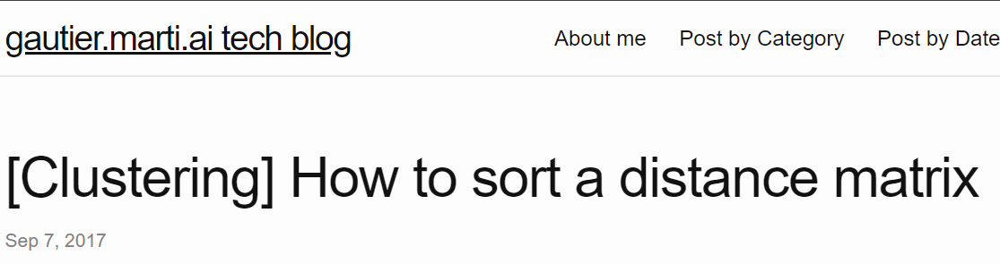
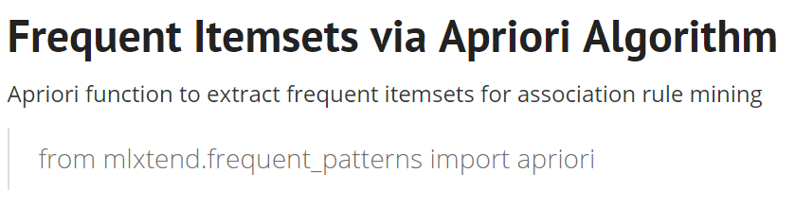
References
Machine Learning with Python
Python Data Science Handbook
An Introduction to Statistical Learning
“Determining The Optimal Number Of Clusters: 3 Must Know Methods”
“How to sort a distance matrix”
“Frequent Itemsets via Apriori Algorithm”

Slide 14
Tables
Column 1 | Column 2 | Column 3
Basic Gold
Column 1 | Column 2 | Column 3
Basic Black
Column 1 | Column 2 | Column 3
Alternating Rows Gold
Column 1 | Column 2 | Column 3
Alternating Rows Black
Column 1 | Column 2 | Column 3 | Column 4
Alternating Columns Gold
Column 1 | Column 2 | Column 3 | Column 4
Alternating Columns Black

Slide 15
Tables
Row 1 | First Column Gold
Row 2
Row 3
Row 1 | First Column Black
Row 2
Row 3
 | Column 1 | Column 2 | Column 3
Row 1 | Header + First Column Gold
Row 2
Row 3
 | Column 1 | Column 2 | Column 3
Row 1 | Header + First Column Black
Row 2
Row 3
 | Column 1 | Column 2 | Column 3
Row 1 | Adv. Gold/Black
Row 2
Row 3
TOTAL
 | Column 1 | Column 2 | Column 3
Row 1 | Adv. Black/Gold
Row 2
Row 3
TOTAL

Slide 16
Charts

Slide 17
Pie Charts

